Slide 1
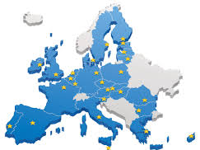

MEDIATORS‘ QUALIFICATION: AN EUROPEAN PERSPECTIVE
Assoc. prof. dr. Agnė Tvaronavičienė
Mykolas Romeris Law School Institute of Public Law
Mediation and Sustainable Conflict Resolution Laboratory

Slide 2

QUALIFICATION OF THE MEDIATOR AS A CORNERSTONE OF MEDIATION
Communication is a two-way street. Parties are both participating in the traffic. Thus, moving in an opposite directions often serves as an obstacle for cooperation.
Mediator is a neutral serving as an accelerator of the communication.
Mediator:
creates an appropriate atmosphere;
identifies needs, concerns and expectations of the parties;
guarantees emotional awareness;
helps parties to identify and verify possible solutions.
Excellence in fulfilling these tasks in most of the cases is a key for the success!

Slide 3
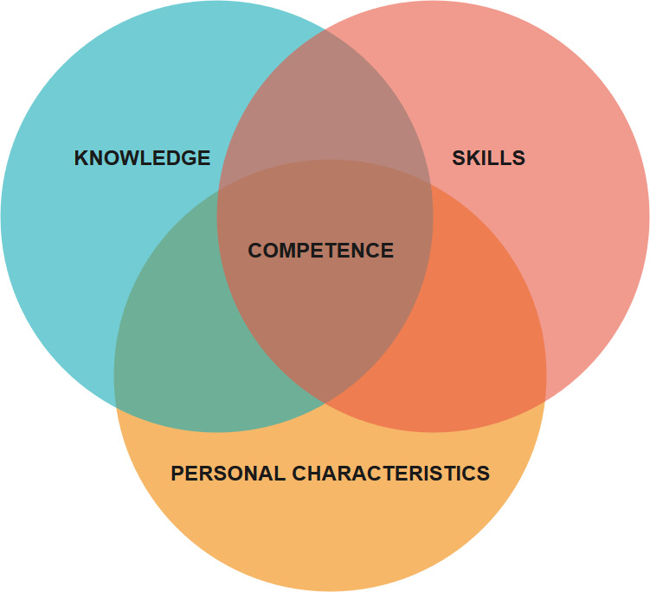
COMPETENCE OF THE MEDIATOR
Competence - a set of characteristics that enable and improve the efficiency of performance of a mediator‘s activities.

Slide 4
HOW TO SECURE THE QUALITY OF MEDIATORS‘ SERVICES?
Rely on responsibility and good will of the mediators‘?
Regulate mediators‘ activities?
„The longer-established and more widespread mediation is as a dispute resolution procedure, the more comprehensive and intensive the regulation of mediators and their associations“ (Hopt and Steffek, 2012)
Main reasons of this phenomena:
need to set universal standards of mediator activity;
necessity to prevent the possible improper behavior of mediators;
attempts of promoting mediation by promising more guarantees of clients‘ right protection.

Slide 5
REGULATING MEDIATORS‘ ACTIVITIES IN EU
Models of regulation:
Authorization model – state admission (certification) is necessary for providing mediation services (e.g., Hungary).
Incentive model – mediator practice open to everyone, still certain legal consequences are ensured only for mediations, which were conducted by mediators, who enjoy state admission (e.g. Germany).
Market model – mediator practice is fully open to everyone (e.g. UK).
These models may be applied not for all mediation systems. As well different models may be applied in the same country in regard of separate disputes.

Slide 6
AUTHORIZATION MODEL
Who is responsible for the admission of mediators?
Ministries of Justice (e. g. Hungary)
Courts, in relation to court annexed mediation (e. g. Portugal)
Other institutions (e. g. Lithuania)
Does the legal regulation impose sanctions for the people serving as mediators without state admission?
In some countries mediator‘s title is protected. It means that person, who uses title „mediator“ without authorization, is committing the administrative offence. E. g. Austria.

Slide 7
INCENTIVE MODEL
Person can serve as a mediator without state admission. Parties should choose state admitted mediator only if they wish to take such benefits of the mediation as:
only in regard of state admitted mediators the certain legislation may be applied;
time limits‘ suspensions are applied only if mediation was conducted by state admitted mediator;
in case of mandatory pre-trial mediation, only state admitted mediator can issue a certificate allowing to start a court action;
parties take an advantage of court fees reduction;
court can use it‘s right not to follow the general rules of litigation costs distribution.
These reasons encourage parties to choose state admitted mediator. As well mediators are encouraged to gain state admission.

Slide 8
MARKET MODEL
Risks in using market model:
there is no control of the mediators‘ qualification;
clients are obliged to take a responsibility for choosing a suitable mediator;
education of the mediators does not play the sufficient role anymore;
standards of the mediation process may not posses an unified form anymore.
Experience of several market model applying countries shows, that state admission in these countries step by step was changed to the certification systems of associations (Chartered Institute of Arbitrators, CEDR, ADR group and etc.). E. g. UK.
N.B. Practice shows, that even state institution relies mostly only on mediators from the certain associations. It drives to conclusion, that function of admitting mediators is non-officially delegated for the private sector entities.

Slide 9
NEW APPROACH TOWARDS REGULATION OF MEDIATORS‘ ACTIVITIES IN LITHUANIA (1)
Till 1 January 2019 the market model was applied towards pre-trial mediation. In regard of court-annexed mediation authorization of the mediators was necessary (authorization model).
Latest amendments brought important changes:
The Lithuanian List of Mediators;
authorization procedure is carried on by State Guaranteed Legal Aid Service;
set of formal requirements for enrolling into the Lithuanian List of Mediators:
  requirements for further qualification improving courses (20 hours in every 5 years period).

Slide 10
NEW APPROACH TOWARDS REGULATION OF MEDIATORS‘ ACTIVITIES IN LITHUANIA (2)
Formal requirements for enrolling into the Lithuanian List of Mediators:
  Higher education;
  Impeachable reputation;
  40 hours of mediation trainings (exceptions are applied);
  Qualification exam (test and practical tasks) (exceptions are applied).
  N.B.
  No age restrictions;
  No specific fields of education identified;
  Exceptional rights for judges to serve as court-annexed mediators.

Slide 11
NEW APPROACH TOWARDS REGULATION OF MEDIATORS‘ ACTIVITIES IN LITHUANIA (3)
What mediation regulation model is applied in Lithuania today? Authorization model v. Incentive model?
According to the Law on Mediation (valid from 1 January 2019):
Mediator is a neutral impartial third person, who fulfils the requirements set by this law and is enrolled into the Lithuanian Mediators list.
Mediation services may be provided only by the mediator, who is enrolled into the Lithuanian Mediators List.
However, there is no legal liability for the person, who served as a mediator without being enrolled into the Lithuanian List of Mediators.

Slide 12
CHALLENGE No. 1 NON EQUAL POSSIBILITIES OF PROFESSIONALS TO BECOME A MEDIATOR
  A wide circle of experienced mediators find as unjust and change requiring exceptions to the general list of formal requirements for the enrollment to the Lithuanian Mediators List.
  Exceptions:
  40 hours of trainings and exam requirements are not applied in regard to:
  lecturers (PhD in social sciences and more than 100 hours of conducted trainings in the field of mediation within 3 years);
  judges, who have 3 years experience and successfully finished non less than 16 hours of introductory mediation trainings.
  Exam requirements is not applied in regard to:
  Attorneys at law, notaries and bailiffs, who have non less than 3 years experience.

Slide 13
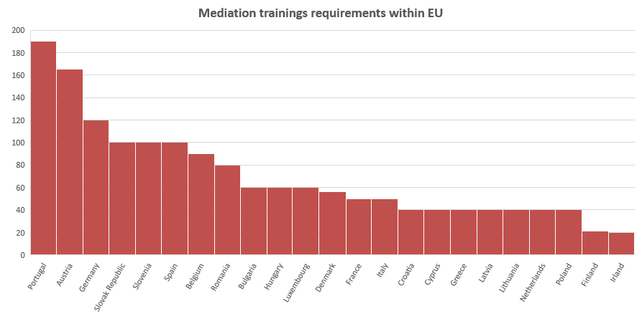
CHALLENGE No. 2 MEDIATION TRAININGS (1)

Slide 14
CHALLENGE No. 2 MEDIATION TRAININGS (2)
CURRENT CONCERNS IN LITHUANIA
Requirement to pass 40 hours of mediation trainings (not earlier than 5 years) raises the demand of trainings.
No requirements for the institutions and lecturers providing mediators trainings create conditions for low quality trainings.
Practicing mediators, who want to be enrolled into the Lithuanian list of mediators, are required to participate in introductory mediation trainings though their knowledge and practical skills are far higher than basic knowledge on mediation.
Detailed mediation training program (approved by the Minister of Justice) cannot be efficiently set out in 40 hours period.
Notes:
In Bulgaria and Italy there are such requirements.

Slide 15
CHALLENGE No. 3 MEDIATION EXAM (1)
Exam requirement within EU

Slide 16
CHALLENGE No. 3 MEDIATION EXAM (2)
The variety of different models of mediator’s exam within EU:
different responsible for examination entities:
  public entities (e. g. Austria);
  private accredited entities (e. g. Bulgaria);
  private entities (e. g. UK).
  different forms of exam:
    written exam (e. g. Slovakia);
    performance-based assessment (e. g. Germany);
    both (prevailing form, e. g. Austria).
    In some countries there is no examinations, but accreditation is performed through checking of fulfillment of certain qualification requirements (e.g. Belgium)
    Other countries does not have neither accreditation based on fulfilment of qualification requirements, neither on examination (e. g. UK).

Slide 17
CHALLENGE No. 3 MEDIATION EXAM (3)
CURRENT CONCERNS IN LITHUANIA
Necessity to find a balance between exam complexity and minimal level of knowledge and skills crucial for the mediation.
Need to find most appropriate form for evaluation.
Professionalism of the members of the examination commission.
Mutual agreement of the members of the examination commission on the uniform standards of exam evaluation.

Slide 18
Quality is never an accident. It is a result of hard work and devotion!
Thank You for attention!

